Slide 1
L6 Group 1
Amy Potter
Daniel Pokladek

Slide 2

Market Psychographic
Mobile platform
Casual game
Daily commute
Gardening, cake decorating and bird watching
2 children and a pet cat called Tigger
Tidy
Patricia, 37 years old
Notes:
Amy: Patricia is a 37 year old woman from Peterborough who commutes to London for work on a daily basis. She enjoys gardening, cake decorating and bird watching during her spare time and uses Pinterest to find interesting recipes that she can experiment with. In addition to her two children, Patricia and her husband have a pet cat called Tigger. The idea of nurturing is important to Patricia as she is an animal lover and is highly eco-conscious. She is also extremely tidy and prefers that her house is meticulously organised is she can help it.

Slide 3
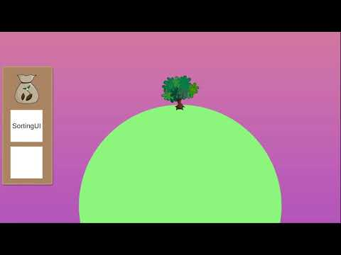
Prototype Video
Notes:
Dan: This is still a prototype scene, in the final game players will start with a blank canvas. We can see the tree slowly growing, and next transition into the sorting screen. From here the players will be able to sort objects into categories to gain rewards, at this moment we have two example categories “Veg” and “Fruit” just to test the system. When players move the item onto the right/wrong category, a energy point is deducted from the player. When the players move the item into the correct category, under the hood, they gain a point. Once they gather enough points, they will be given a reward. For the sake of the prototype, when player sorts 5 carrots, they gain a tree in their inventory. As can be seen on the screen, the player run out of energy and couldn’t sort the object. To regain energy players harvest fully grown trees. Now that we sorted one more item, we have received our tree and we can plant it on our planet and watch it grow.

Slide 4
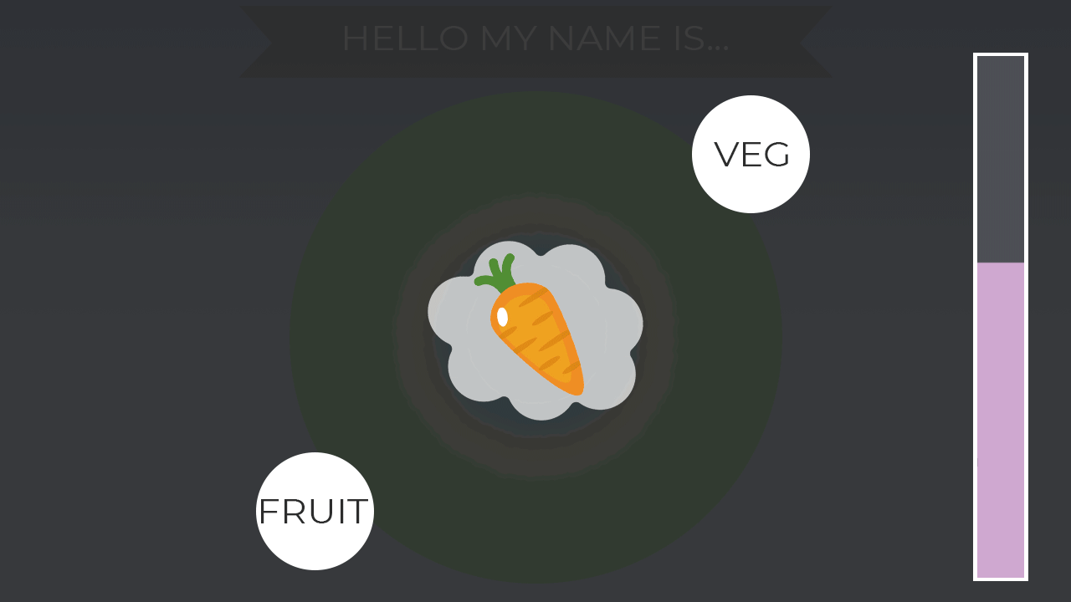
Sorting
Notes:
Dan: This is the concept art we have for the sorting mechanic. As shown in the prototype, players are presented with an object in the middle of the screen. They must drag the object to a category, which will drain their energy by one. As an element of progression, players will be able to unlock further categories and objects to sort, which will allow them to obtain more rewards.

Slide 5
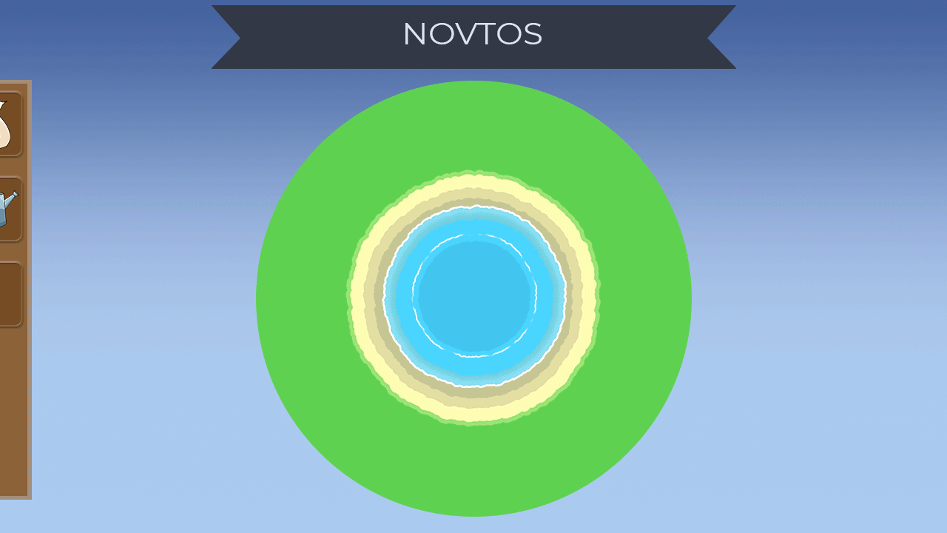
Planting
Notes:
Amy: The game rewards players with seeds that they can use to decorate the planet. Once these objects have grown, players will be able to collect stars which will replenish their energy bar and allow them to continue sorting. For the purpose of MVP, the objects grow relatively quickly so that we are able to test features such as energy replenishment. Later on, we will develop a spreadsheet that details how long each object takes to grow and how many stars it rewards upon harvest, this will be dependent on its rarity and the point at which the player is able to unlock the seed.
We also intend to implement a growth tick so that players are required to water their plants every 6 hours. This taps into the idea of nurturing and gives the player a reason to come back to the game.

Slide 6
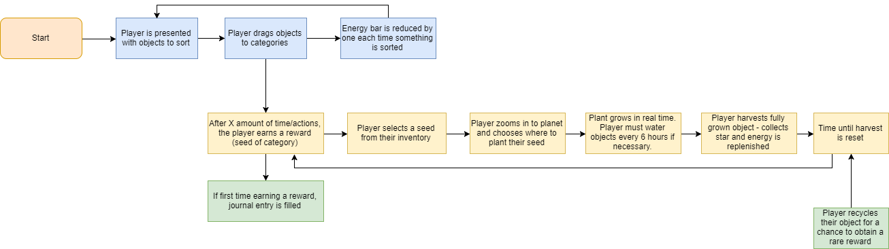
Flowchart
Notes:
Amy: This flowchart details the core elements of our game. As mentioned before, the sorting of objects acts as the main mechanic in the game and allows players to unlock seeds and new categories via reward schedules. In order to continue sorting, players are encouraged to harvest their plants in order to gain stars and replenish their energy. In order to prevent players having to wait for a long time, the energy replenishes itself over time and stars can also be earned through collecting seashells or seaweed on the beach. However, the energy via this method is lower in value and thus is a suboptimal choice over growing and harvesting plants.

Slide 7

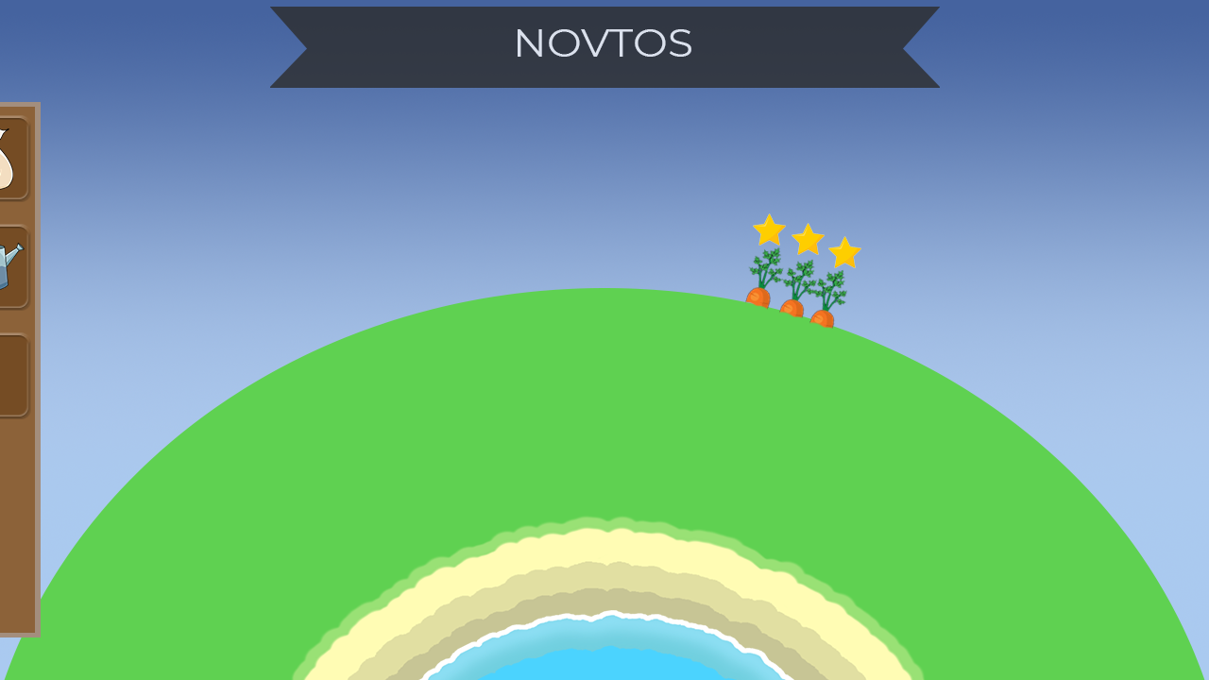
Progression and Player Choice
5 minutes into the game, after tutorial
Notes:
Dan: By the end of first 5 minutes of gameplay, our players would have completed the initial tutorial. From there they would be allowed to explore the game on their own, and decorate their own planet. Under the hood there is variable that keeps track of how many objects players have sorted correctly; with this variable we keep track of player’s progress, so that we can reward them with new categories and more rewards from sorting. Starting rewards have shorter growth time, compared to late game items..

Slide 8
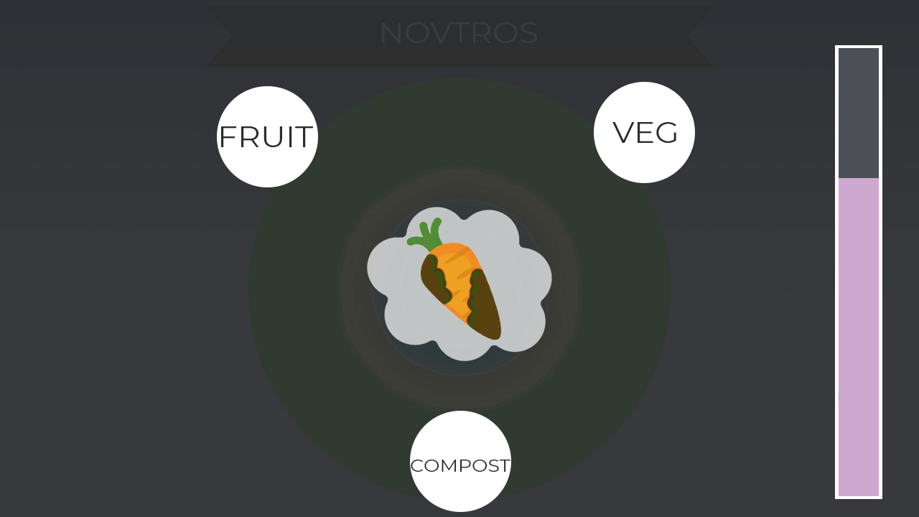
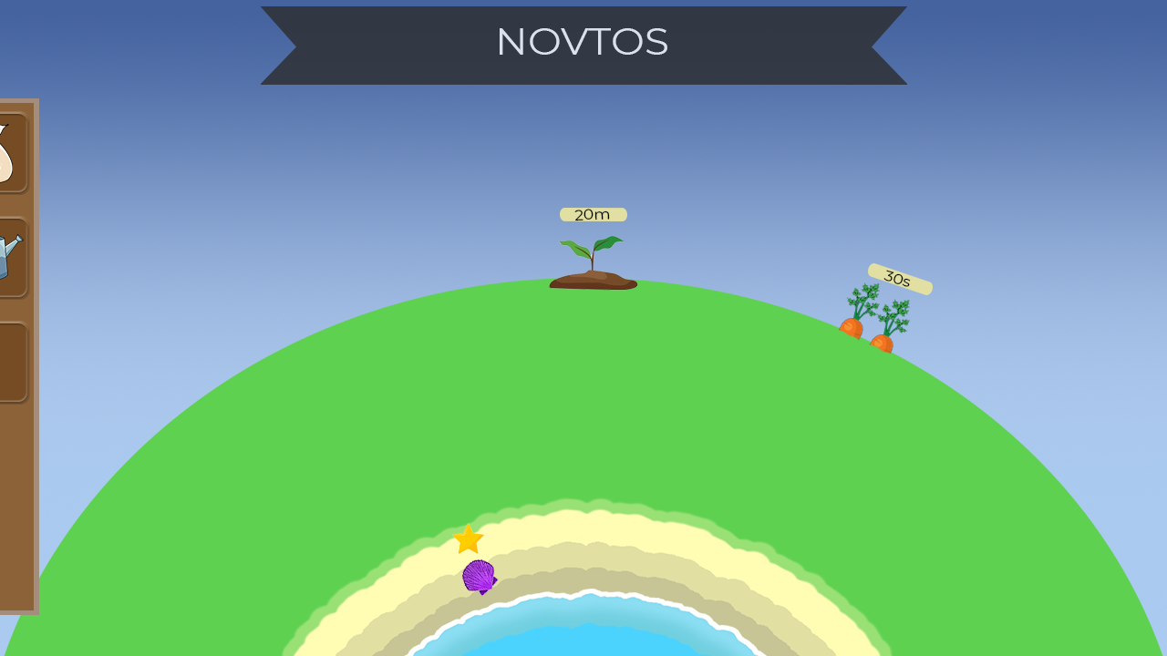
Progression and Player Choice
10 minutes into the game
Notes:
Dan: Once the player has sorted 50 items correctly, they will unlock the new category. The new category brings in new items that the player can sort; with this category players will start sorting rotten fruits and veg into the compost category; this will have a chance of rewarding the player with a heap of compost. The heap will start forming and it will take an hour before it appears in players inventory. Once its in player’s inventory, they can use it on their plants to increase the yield of energy stars.

Slide 9
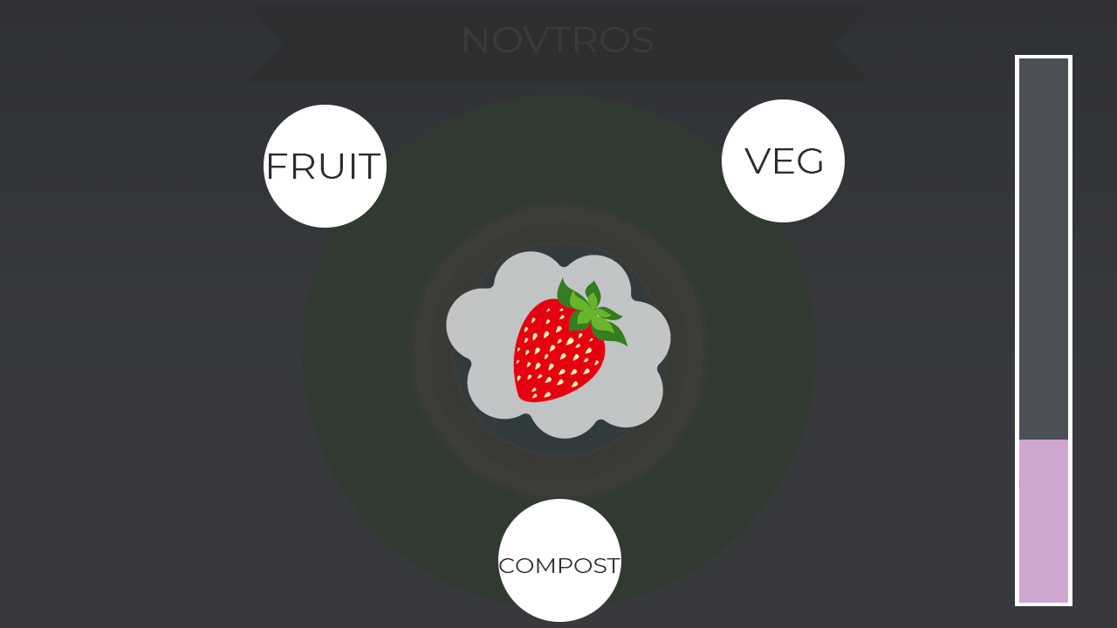
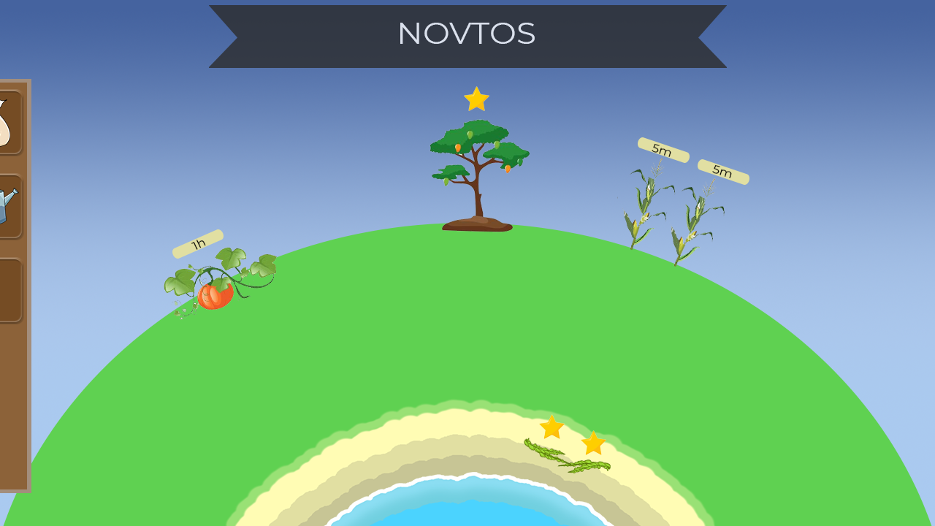
Progression and Player Choice
30 minutes into the game
Notes:
Amy: While the sorting mechanic itself has not changed, the player has now unlocked further rewards which they have grown to provide energy that can be used to progress further through the game. In order to add an element of player choice and further variety, players will be given the option to recycle their fully grown plants for a chance to obtain a rare reward that can’t otherwise be obtained through sorting. Recycling is accessed by tapping an object on the planet and clicking the recycling icon.

Slide 10
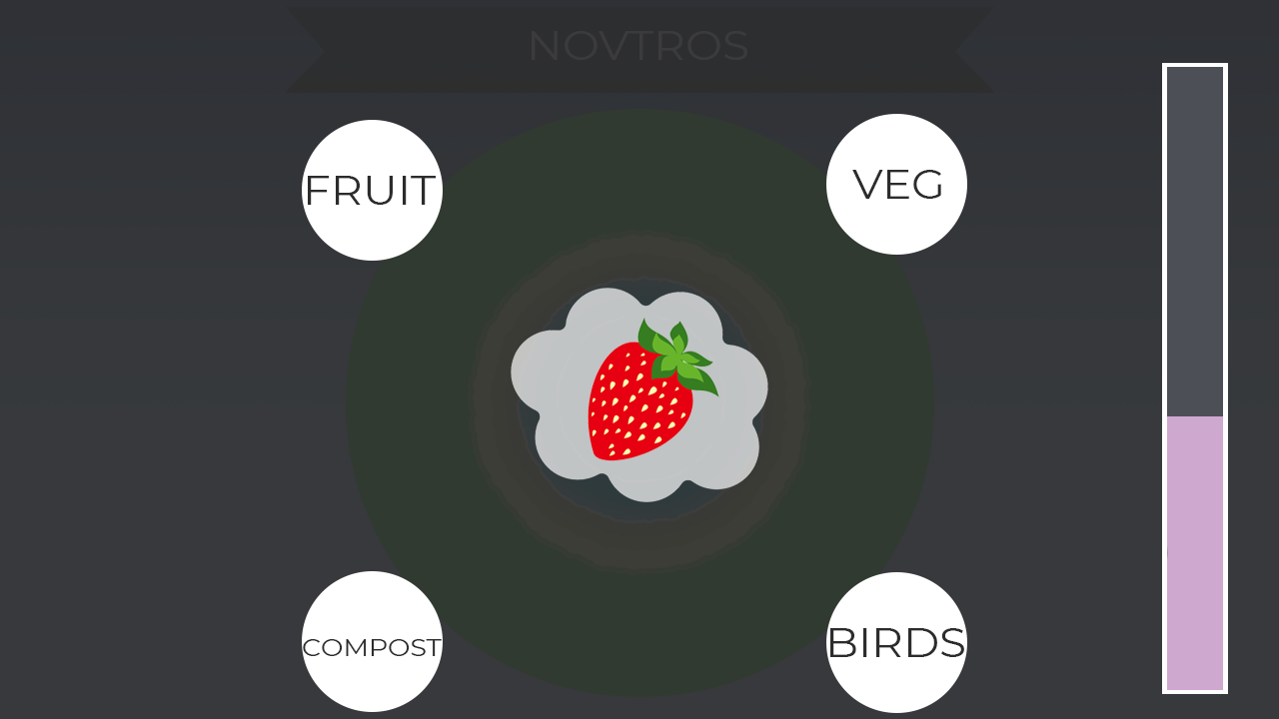

Progression and Player Choice
1 hour into the game
Notes:
Amy: As before, the player has unlocked a new category from correctly sorting objects, which allows them to earn further rewards. As of yet, we haven’t honed in on how we can make progression more interesting for the player and this is something we are looking to investigating over the next couple of weeks.

Slide 11
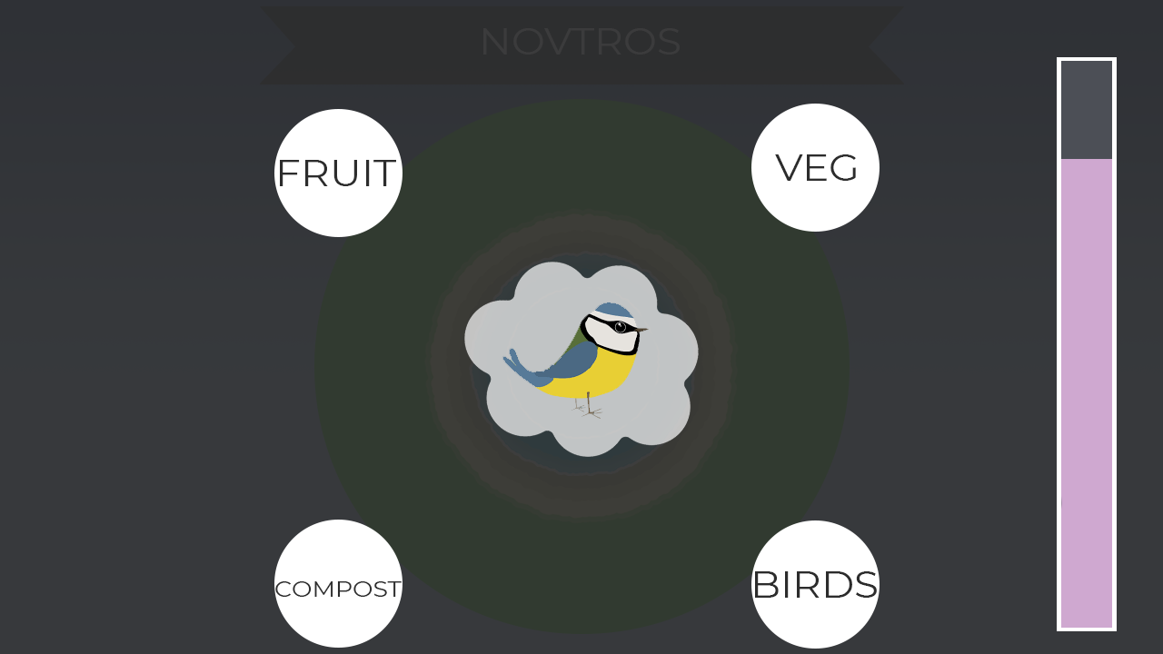
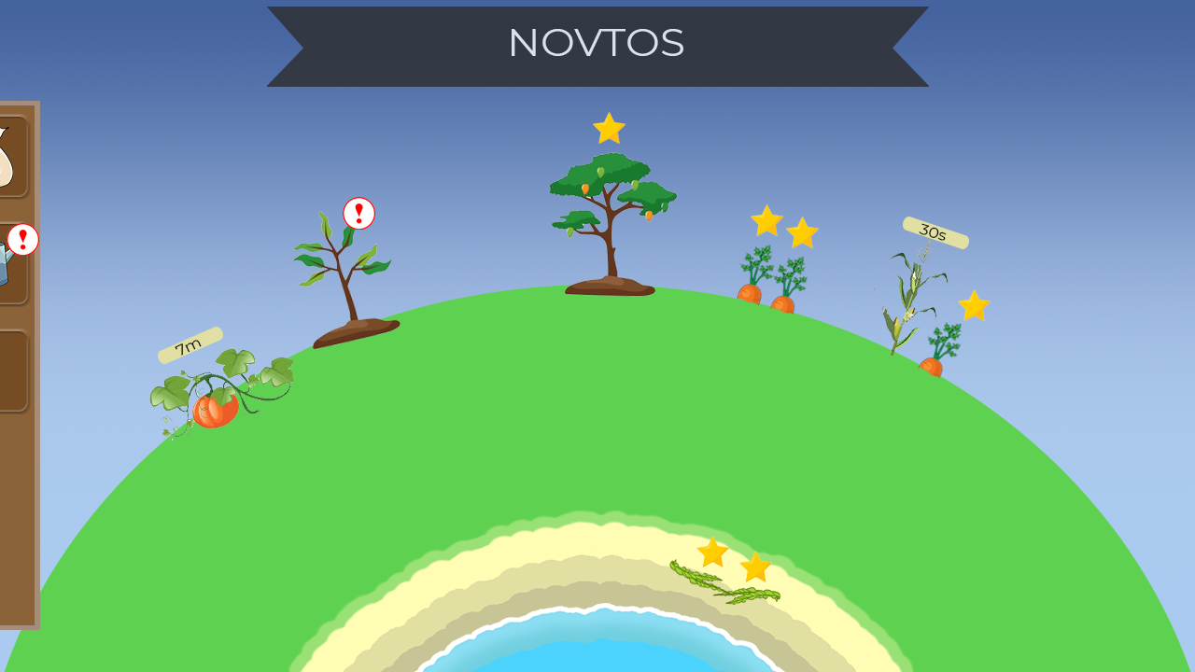
Progression and Player Choice
6 hours into the game
Notes:
Dan: After 6 hours of play, players will need to water their plants in order to encourage them to keep growing.
Discuss future implementation of progression: Since Patricia enjoys organising and managing, as the progresses we will give her more to manage. An example of this could be providing each seed with a set of attributes that start by being assigned randomly by the game itself, with Patricia taking control of these attributes further on. This will also add to the variety between players planets since there will a small selection of attributes to choose from. However, this will not be puzzling for Patricia, in order to maintain the high level of casual play that she usually enjoys.

Slide 12
Reward Schedules
Categories and seeds unlock based on sorting points
Variable ratio schedule
Notes:
Amy: Category unlocks are earned after a particular number of sorting points have been earned, but the required number increases with each new category you unlock. For example the first category may require 50 points to unlock whereas the next may require 250.
Seeds rewards are also earned via a variable ratio schedule, where the players must earn a certain number of sorting points to obtain a reward, but the number of points required changes each time. By allowing the player to see their journal filling new entries, this positive reinforcement may encourage them to continue sorting in attempts to unlock new rewards and ultimately strive towards completing their journal. By deepening our understanding of our psychographic in the future,we will be able to drill down into further details such as the type of rewards that will be available to unlock, as well as how they will appear and their frequency.

Slide 13
Appealing to the Psychographic
Casual
Easy to learn
Completion and design
Real world
Nurturing
Notes:
Amy: By creating a game that requires casual mechanics such as sorting, we appeal to Patricia since she doesn’t need to develop a new skill in order to play. This means that there is only a short amount of time required to become proficient in play and thus the game can be played without much thought during work breaks, the daily commute or for a moment of relaxation at home.
Since the sorting revolves around extrinsic information based on the real world, there will also be no need for Patricia to learn anything new and thus the game is accessible to her.
Patricia is a particularly tidy person and therefore enjoys bringing order to chaos, which is demonstrated via our sorting mechanic. This, in conjunction with the idea of nurturing the environment taps into Patricia’s eco consciousness and enjoyment of gardening, therefore making our game appeal to her through her interests. Drawing on the success of Farmville, our game taps into the idea of signalling; where having a tidy and well-tended planet may be a signal of how responsible you are, which may associated with being a good parent.

Slide 14
Key Next Steps
To reach MVP
Design the rewards the player can obtain
Design the objects that grow/appear from these rewards
Consider how we can implement progression mechanics
Implement “growth tick”
Refine the energy system
Notes:
Dan. We will get the rewards and objects to plant from the research into awe & wonder; progression research. Next step is to fully research the progression of the game past the initial 6 hours, and refine the current progression concept. We also need to refine how the energy system work, and the naming.

Slide 15
Any Questions?
Notes:
Glad Alex is not here to rip us for this part… :’)

